Slide 1
My Hobby
Systems for internet

Slide 2

Languages for program

Slide 3
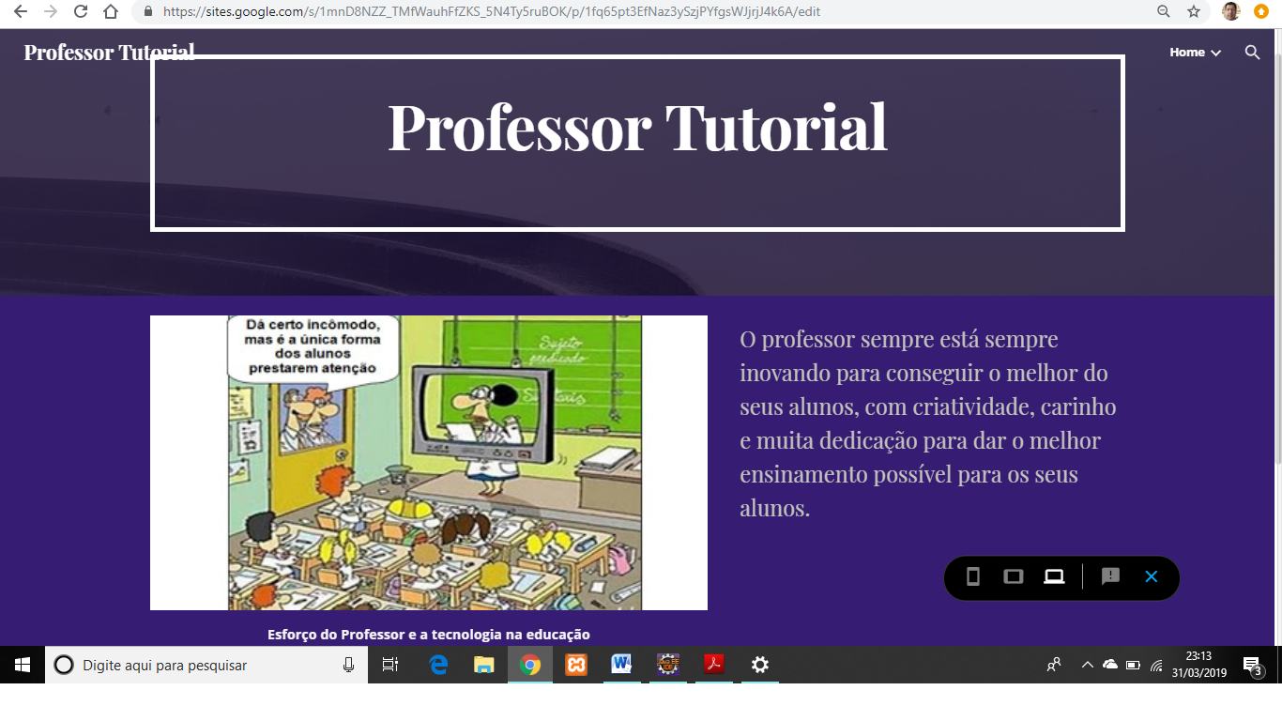
website to help make simple websites

Slide 4
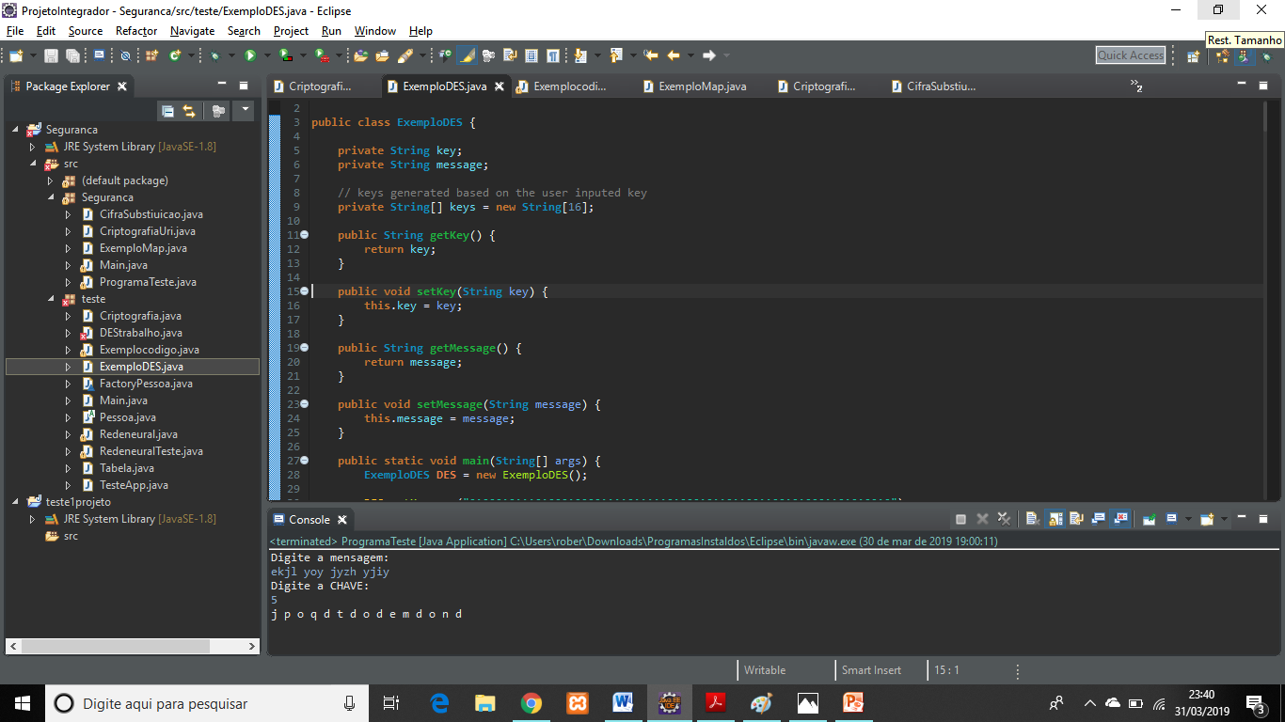
Java

Slide 5
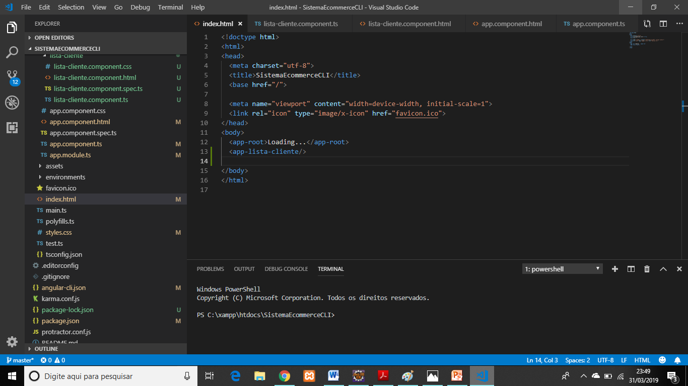
Visual Studio Code

Slide 6
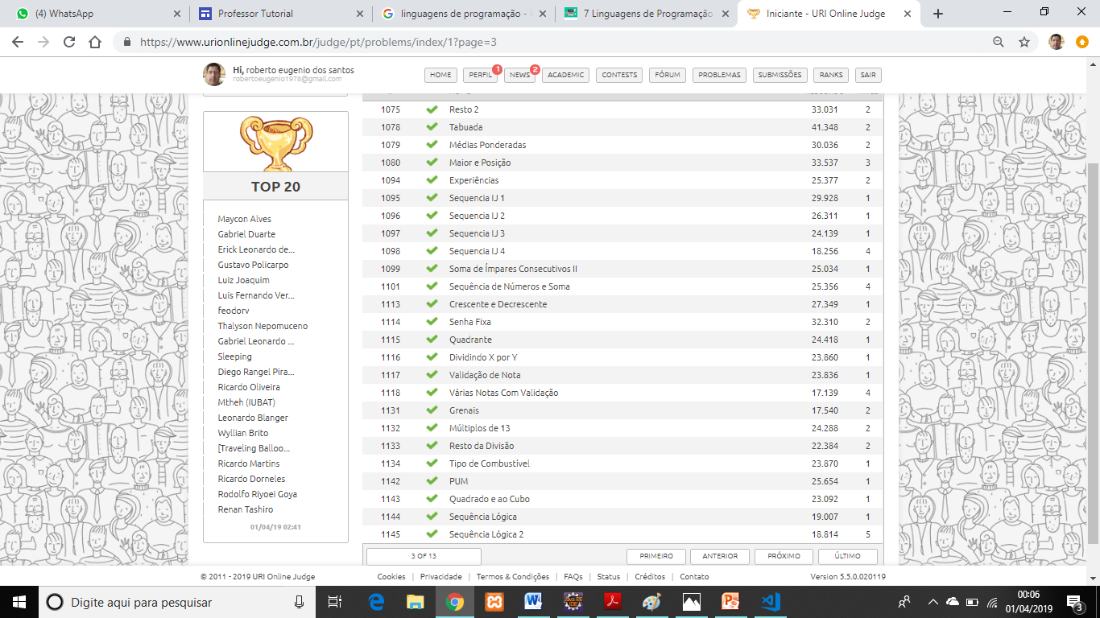
Site uri online judge

Slide 7


